Slide 1
Southwest Region Leadership Retreat
Hot Springs, AR
November 14, 2015

Slide 2
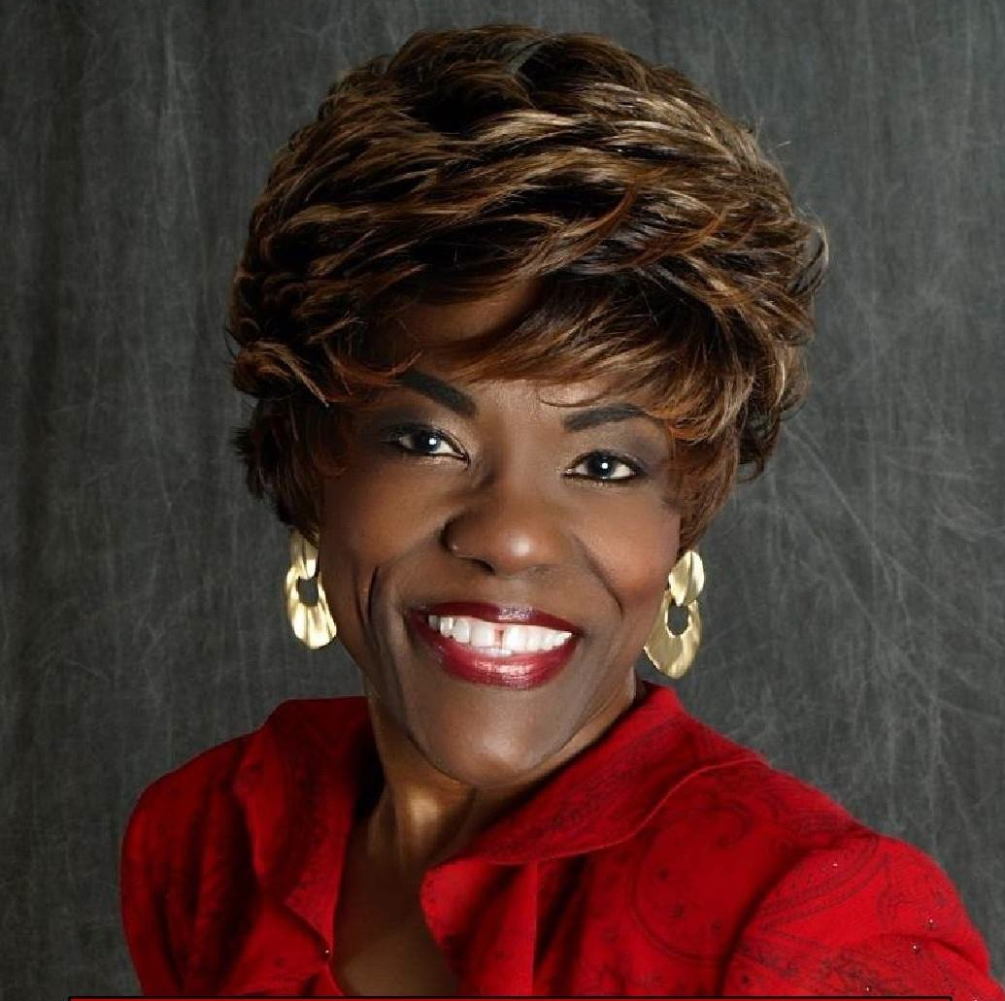
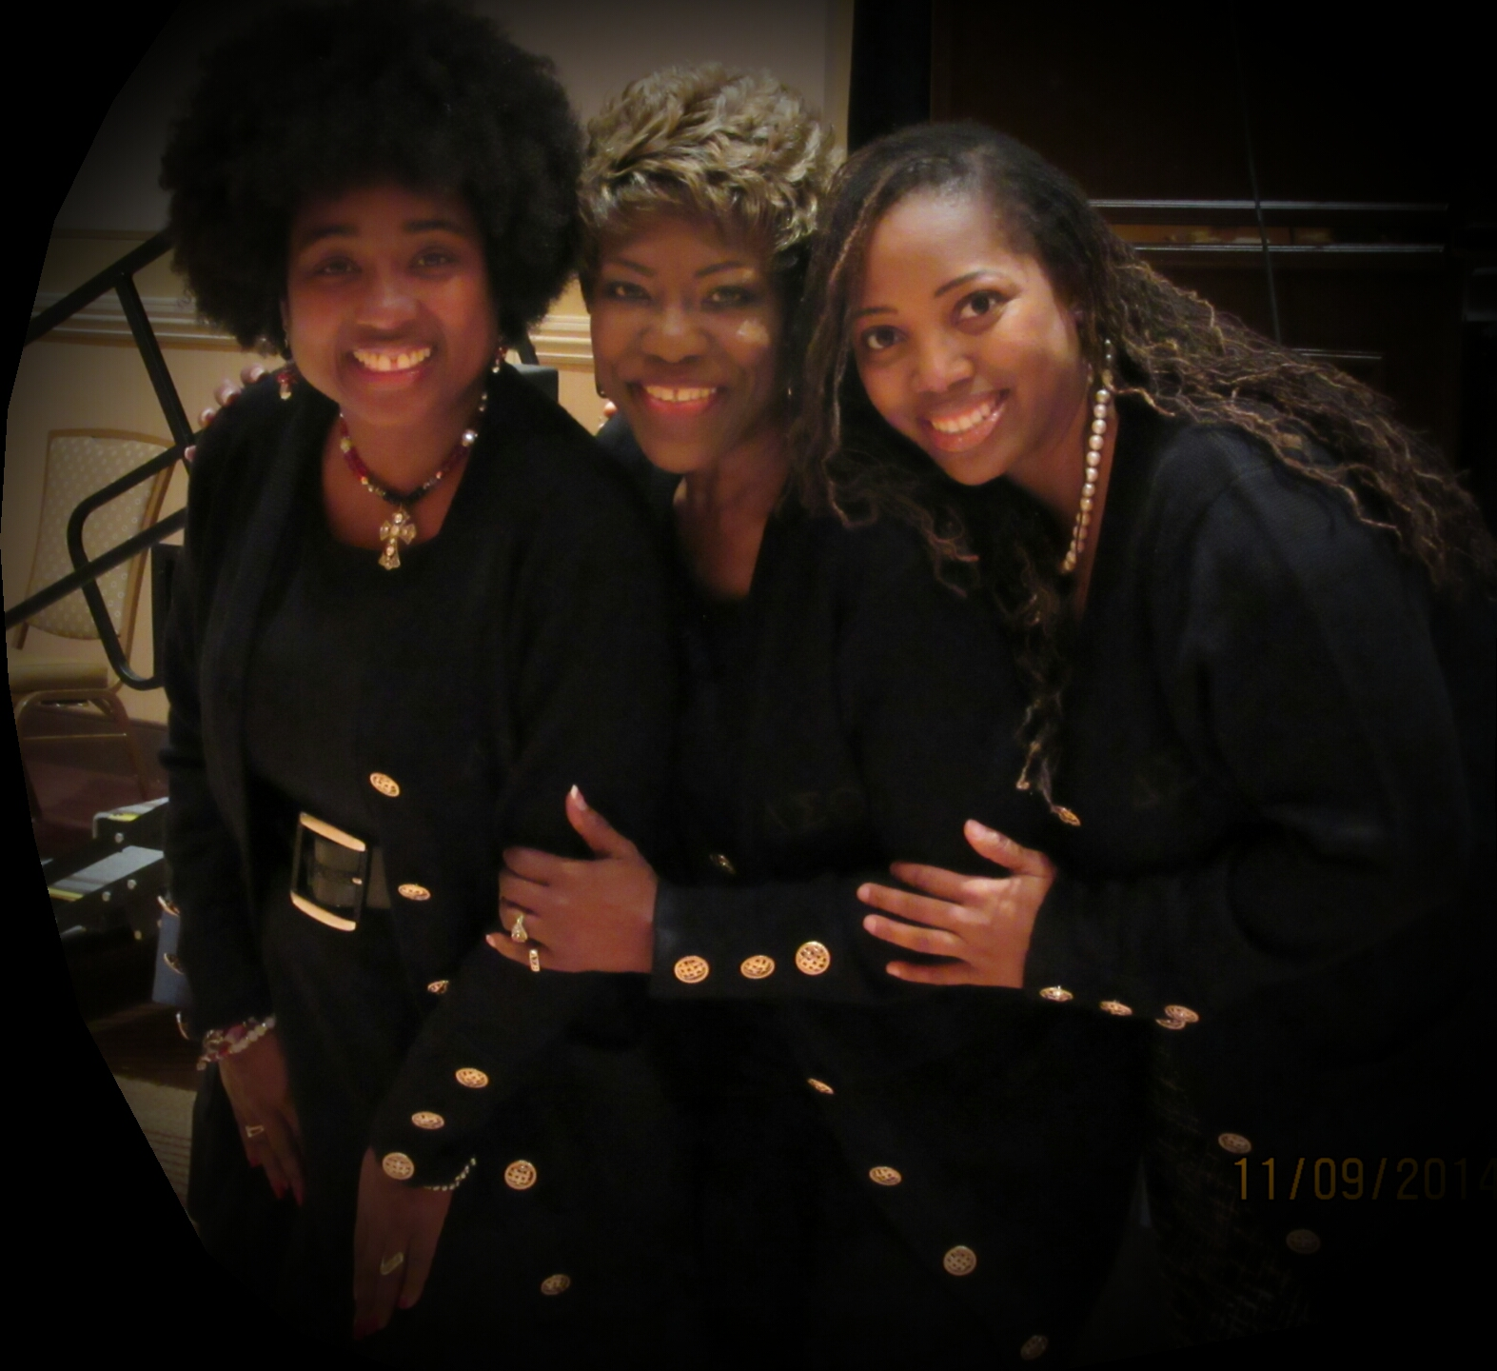
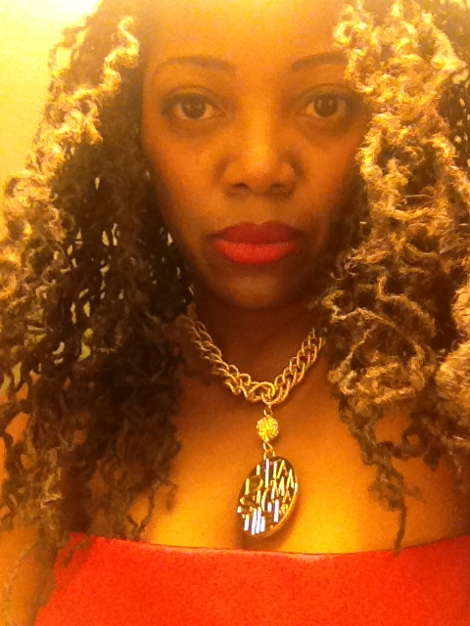
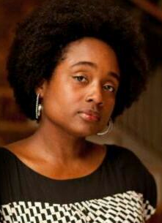
Charlene D. Ayers (TX)
yofren@sbcglobal.net
Atty. Felicia M. Hamilton (LA) feliciasings@yahoo.com
Genine L. Perez (AR)
genine@geninelperez.com
National Arts & Letters Commissioners
Notes:
Again, we are fortunate to have a National Commissioner located in AR, LA, & TX. We will be around throughout the weekend. Be sure to introduce yourself and allow us to be resources for you. Do not hesitate to contact us.

Slide 3
Angela D. Brown

Slide 4
Tawana Butler

Slide 5
Phyliss Dixon

Slide 6
Alice Faye Horton

Slide 7
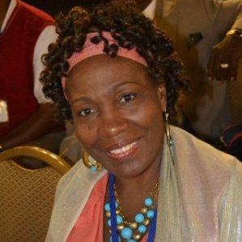
Shirley Inkton-Bowers

Slide 8
Victoria Christopher Murray

Slide 9
Dr. Michele R. Wright

